Slide 1
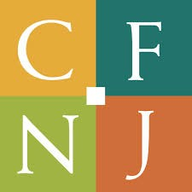
What the growth in Donor Advised Funds means for philanthropy
Hans Dekker
Community Foundation of New Jersey

Slide 2
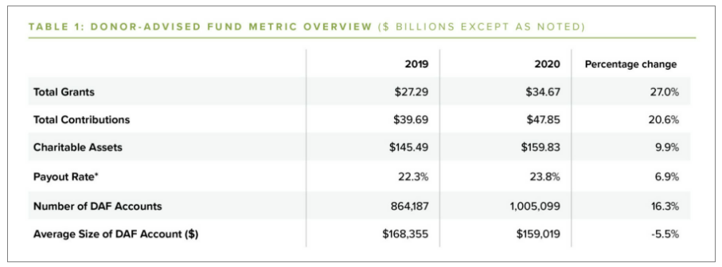
Donor Advised Funds extend their decade-long growth in every metric.
This is the highest DAF grant increase in a decade.
Notes:
https://www.nptrust.org/reports/daf-report/

Slide 3
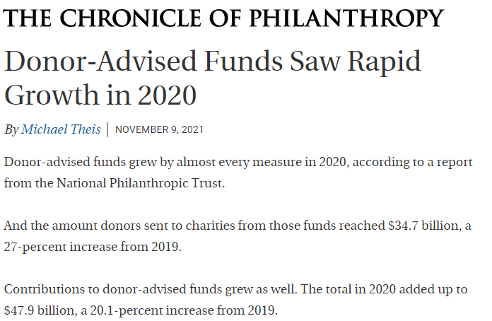
2020 was noteworthy for growth in DAF assets, numbers, grantmaking.
The DAF payout rate was 23.8 percent, one of the highest payouts on record.
Payout has remained above 20 percent for every year on record, reflecting the consistent charitable support that DAF donors provide.
Other key metrics, like contributions and charitable assets, also increased.
The number of individual DAF accounts in the U.S. is above one million for the first time.
Notes:
https://www.nptrust.org/reports/daf-report/

Slide 4
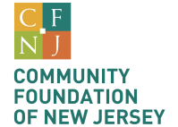
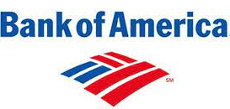
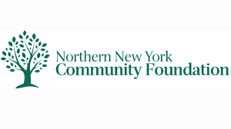
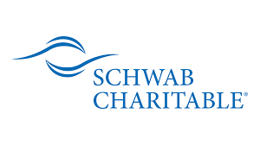
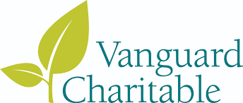
Who offers DAFs
Community Foundations
650 across the United States
National Banks

Slide 5
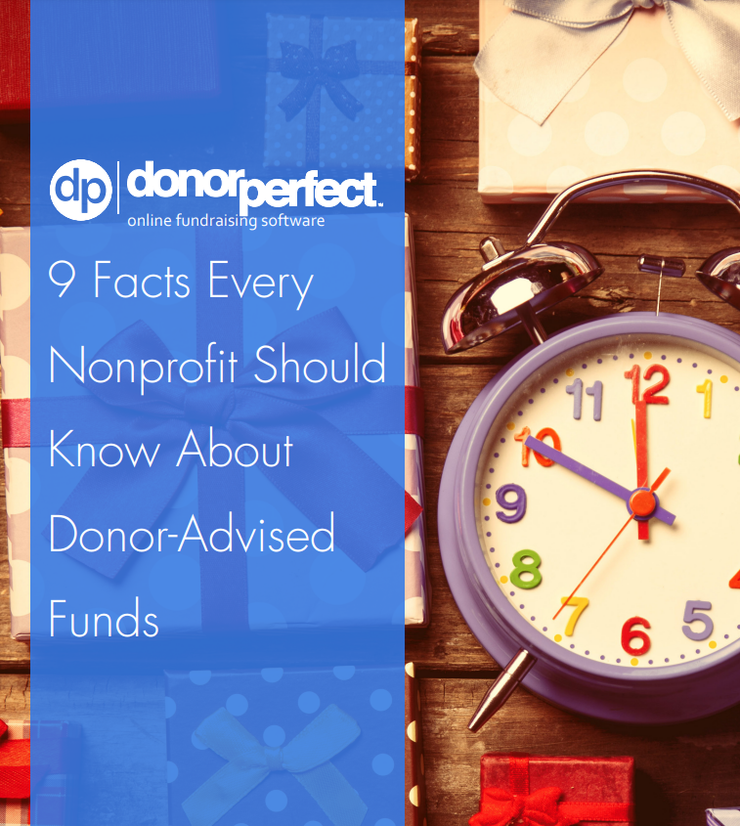
Accessing DAFs has become a cottage industry
But there’s no silver bullet.
Track gifts
Cultivate donors
Treat DAFs as individual donors

Slide 6
Why DAFs matter to nonprofits.
DAFs hold a lot of wealth.
Donor are making more grants from DAFs than ever before.
DAF donors are loyal to the organizations they support.
Donors are turning to DAFs more than ever before.

Slide 7
Thinking about the solicitation for DAFs

Slide 8
Donors have a lot of options for charitable vehicles.
 | Private Foundation | DAF at a national bank | DAF at a community foundation
Flexibility on investments |  |  | ✓
Higher deduction on AGI as compared to private foundations |  | ✓ | ✓
Ability to give beyond 501c3 organizations |  |  | ✓
Opportunity to donate non-publicly traded assets |  |  | ✓
Talk to a dedicated fund representative who lives in (and cares about) your community |  |  | ✓

Slide 9
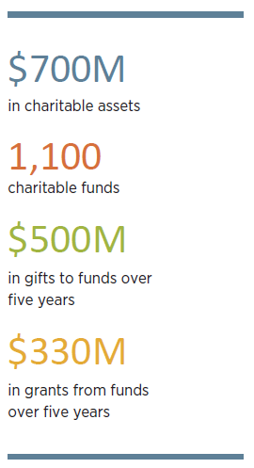
Snapshot of our fundholders’ 2020 philanthropic impact

Slide 10
Comparing DAFs, supporting org.’s, and private foundations
 | Donor Advised Fund | Supporting Organization | Private Foundation
Creation | Established by agreement with the Foundation | Nonprofit corporation created with assistance from the Foundation | Nonprofit corporation or trust organized as a private foundation
Tax-exempt status | Shares 501(c)3 tax-exempt status of the Foundation as public charity | 509(A) public charity | Must apply for private foundation tax-exempt status from the IRS
Costs (start-up and annual) | No start-up expenses; annual administrative fee | Small start-up costs through collaboration with the Foundation; annual filing fees assessed to the Supporting Organization | Similar to corporate start-up
Charitable deductions | Tax deduction of up to 60% of adjusted gross income; maximum for donor allowed by law | Tax deduction of up to 60% of adjusted gross income; maximum for donor allowed by law | Tax deduction limited to 30% of adjusted gross income
Non-publicly traded assets | Deduction is based on the fair market value of the asset | Deduction is based on the fair market value of the asset | Deduction is based on donor’s basis
Donor control | Advisor makes grant recommendations | Donor may appoint members of the board of directors with the Foundation appointing the majority of members | Donor appoints board with control over investments and grantmaking, subject to IRS requirements
Payout requirements | No required payout | Spending policy determined at the establishment of the fund | Must pay out for charitable purposes at least 5% of its investment asset value regardless of annual income
Annual taxes | None | None | Generally income is tax exempt but subject to excise tax of up to 2% of net investment gain including net capital gains
Annual tax filings and returns | Reported as part of the Foundation annual reporting; donor lists are confidential | Prepared and filed by the Foundation; donor lists are confidential | Must be filed by the private foundation with required supporting schedules; donor lists are public information
Investments | Donor selects from four pools to invest in or may recommend an independent manager (minimums apply) | Donor selects from four pools to invest in or may recommend an independent manager (minimums apply) | Must secure its own investment services

Slide 11
Handicapping Potential Federal Regulations on DAFs
Emergency Charity Stimulus to institute a three-year 10% mandated annual payout for donor advised funds
Initiative to Accelerate Charitable Giving to require private foundation and donor advised funds to be distributed (or advisory privileges are released) no later than 15 years from the year of the donation to the private foundation or donor advised fund
Universal Giving Pandemic Response and Recovery Act to expand and extend the current deduction for charitable giving (at a higher level than the current $300 deduction)

